Slide 1
Advanced Language and EFL Methodology British Study Centres School of English Oxford PROJECT: „Mobility of school education staff” is co-financed by the European Union in the framework of the European Social Fund

Slide 2
NEW INSPIRATIONS
UNPLUGGED TEACHING - DOGME
Dogme is the belief that:
language is more memorable if it
emerges in a personal context.
SLA is non-linear and language
teaching should reflect that.
by listening and asking students
about their own lives and
opinions, language issues such as
grammar, lexis, pronunciation will
naturally "emerge”
taking away the "protection of the course books" from both teacher and student frees a space for more real learning. Emi Slater
“The teacher’s job is to exploit the vast resources already in the classroom - the students”
Scott Thornbury and Luke Meddings 2009
http://www.englishclub.com/esl-videos/thoughts-from-brazil/index.htm Video of Dogme lesson in Brazil
Teaching Unplugged: Dogme in English Language Teaching
Book by LUKE. THORNBURY MEDDINGS (SCOTT.) and Scott Thornbury

Slide 3
STORY CUBES
Story Cubes are a versatile Literacy and story-telling tool for teachers and children to use in their classrooms. There are 9 dice, with a total of 54 images. By rolling the dice, a different set of images is produced which can be used as the starting point for a story or for other Literacy work.

Slide 4
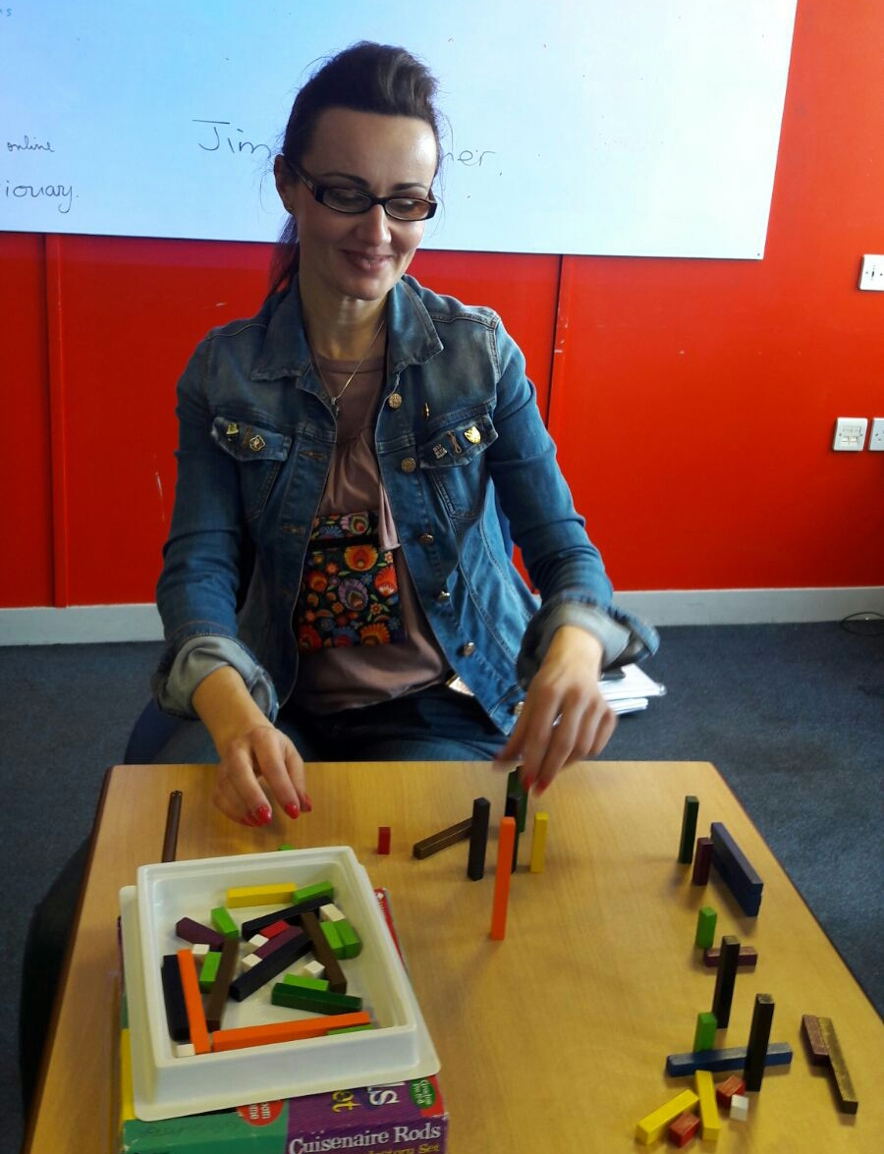
CUISENAIRE RODS
There are many ways of using Cuisenaire rods in the classroom:
Storytelling
Using rods for teaching phrasal verbs
Presenting language chunks
Further reading
Stevick, E.W. 'Teaching and Learning Languages' C.U.P. 1988

Slide 5
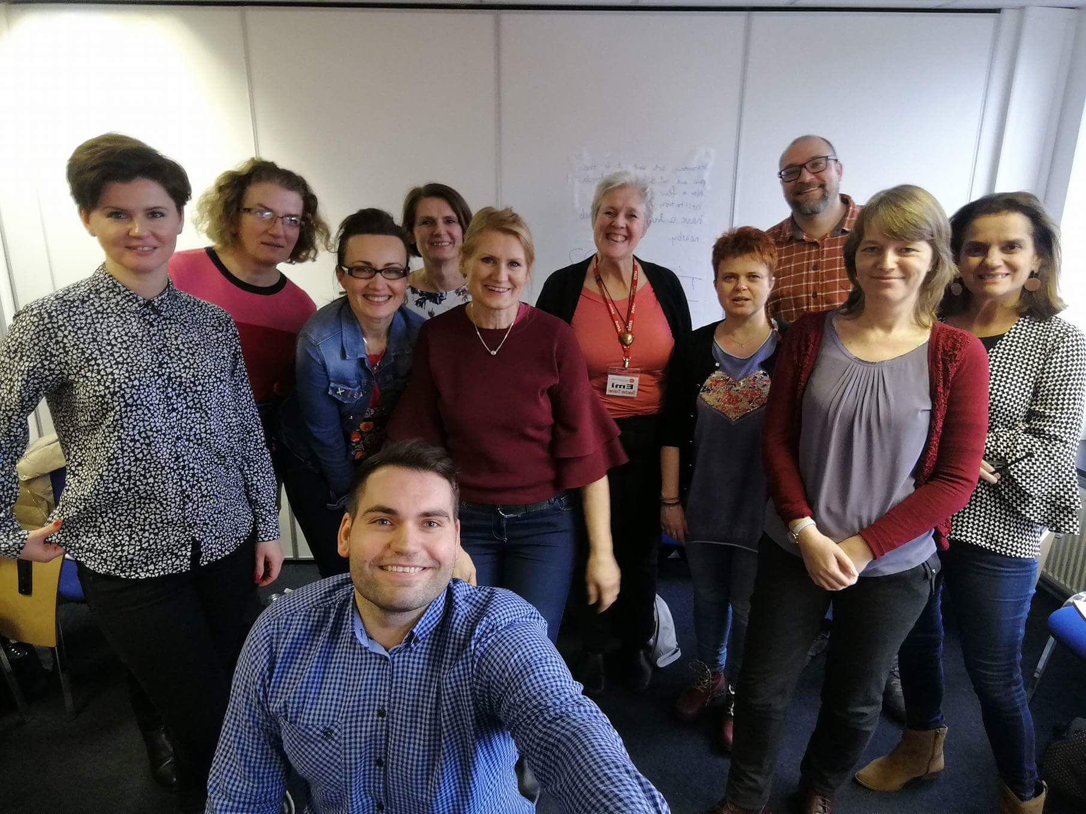
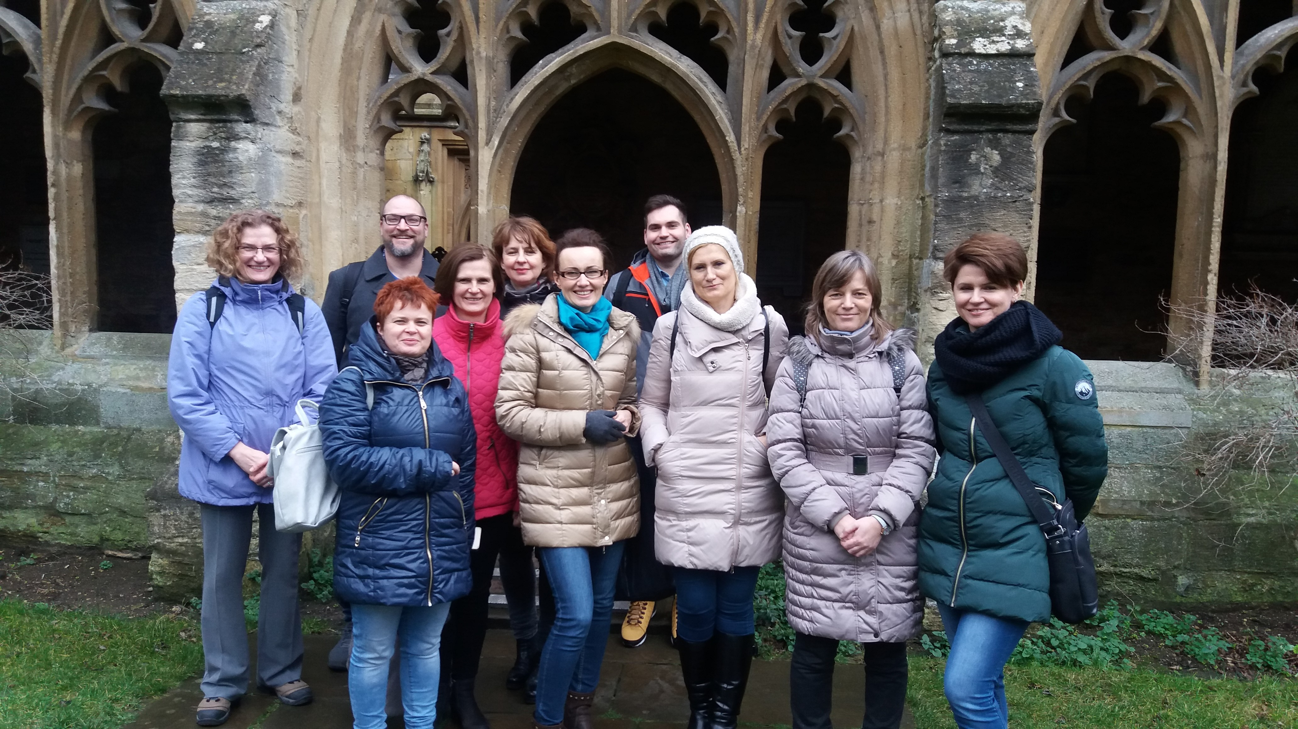
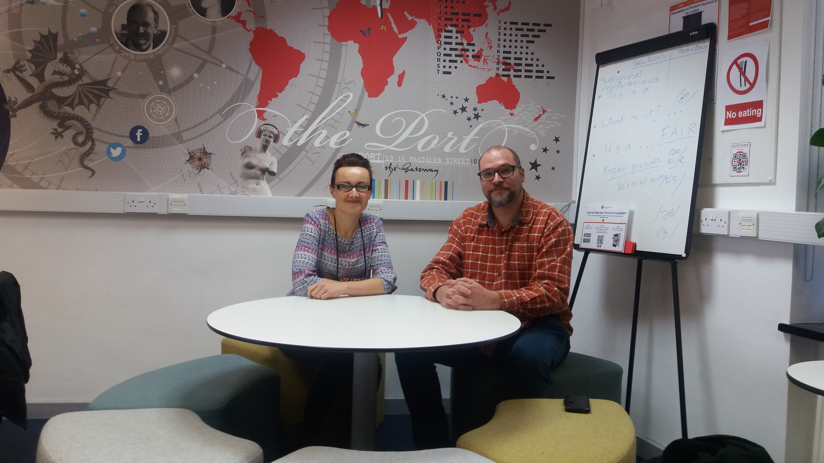
SHARING EXPERIENCE

Slide 6
PLANNING INTERNATIONAL PROJECTS
having students exchange information about their own countries
online interaction – social media, blogs, vlogs
discussing universal problems around the world – tourism, international news
https://www.youtube.com/watch?v=KEuaSRS77nw&feature=youtu.be

Slide 7
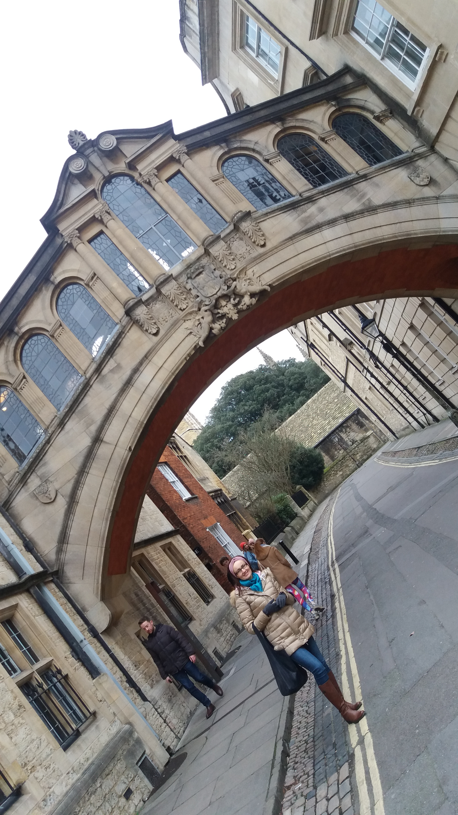
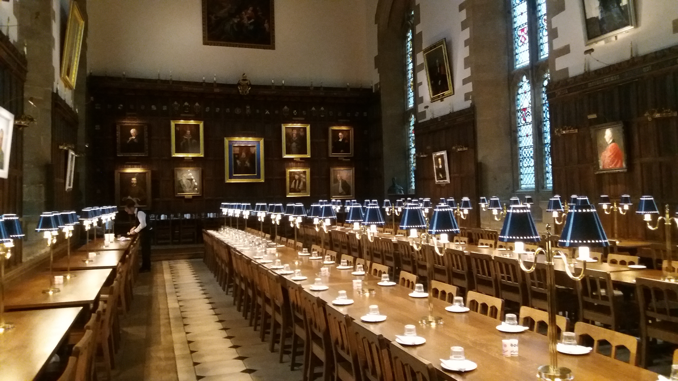
FOLLOWING HARRY POTTER’S FOOTSTEPS IN OXFORD

